Slide 1
Team Introduction
Project Team & Researchers
Viraj Shah
Project Lead
Ananthi Siva
Team Member
Chanchal Sakarwar
Team Member
Rajashekar Reddy Mettu
Team Member
Sreedhar P Reddy
Team Member

Slide 2
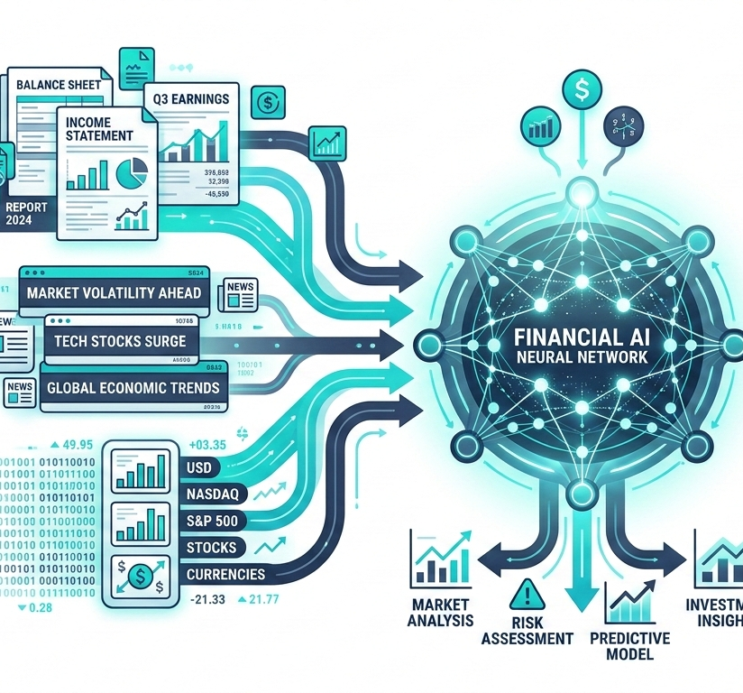
Financial Sentiment Analysis with Statistical Models, Deep Learning & LLMs
Evaluating multi-architecture NLP performance on complex domain-specific financial text
PROBLEM DEFINITION
This project investigates the application of Statistical Models, Deep Learning Based Models, and Large Language Models (LLMs) for Financial Sentiment Analysis (FSA).
We benchmark models like GPT-OSS-120b, GPT-OSS-20b, Qwen3.8-27b, and Gemini-Flash-Lite-Latest against domain-specific API models on complex financial texts.
PROJECT OBJECTIVES
Extracting opinions and market sentiment from diverse financial data sources:
article
Financial news articles
analytics
Comprehensive financial reports
campaign
Official company announcements

Slide 3

Real-World Applications of Financial Sentiment AI
How LLMs process unstructured market data into real-time trading signals, earnings analysis, and enterprise risk intelligence.
trending_up
ALGORITHMIC TRADING & SIGNALING
Automating buy/sell signals by ingesting real-time financial news and SEC filings, enabling high-frequency models to execute trades fast.
01
analytics
EARNINGS CALL & ANNOUNCEMENTS
Parsing executive tone and complex financial statements during earnings releases to measure corporate health and leadership sentiment.
02
shield
ENTERPRISE RISK & INTELLIGENCE
Monitoring systemic market risks, credit default signals, and regulatory news to provide portfolio managers proactive risk mitigation insights.
03

Slide 4
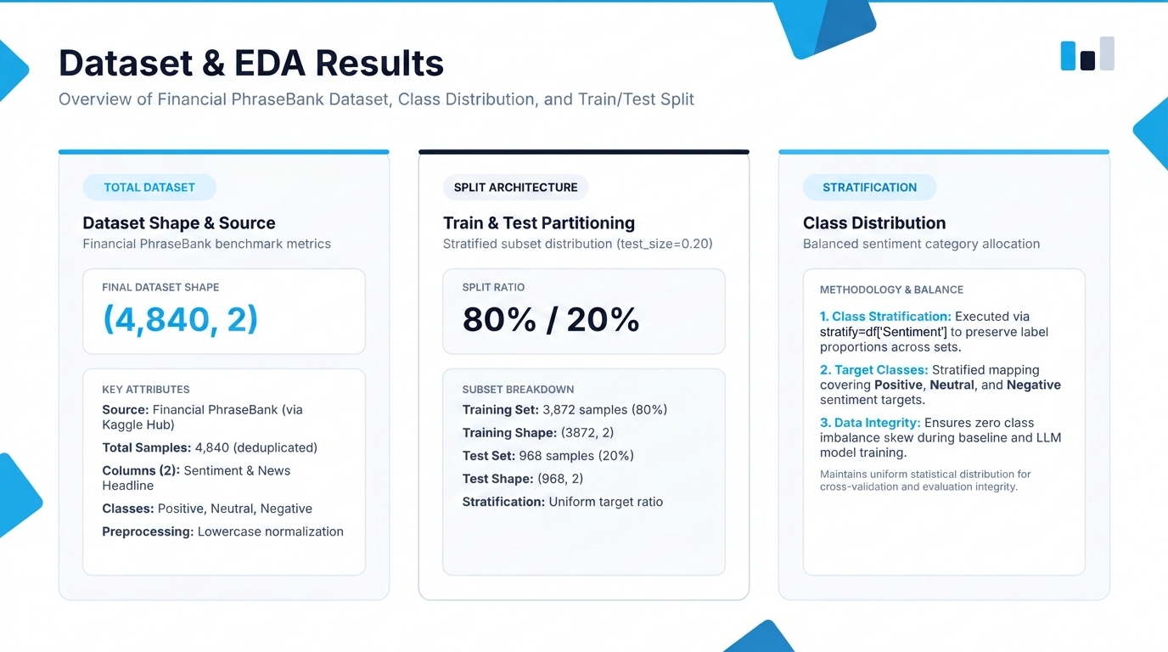

Slide 5
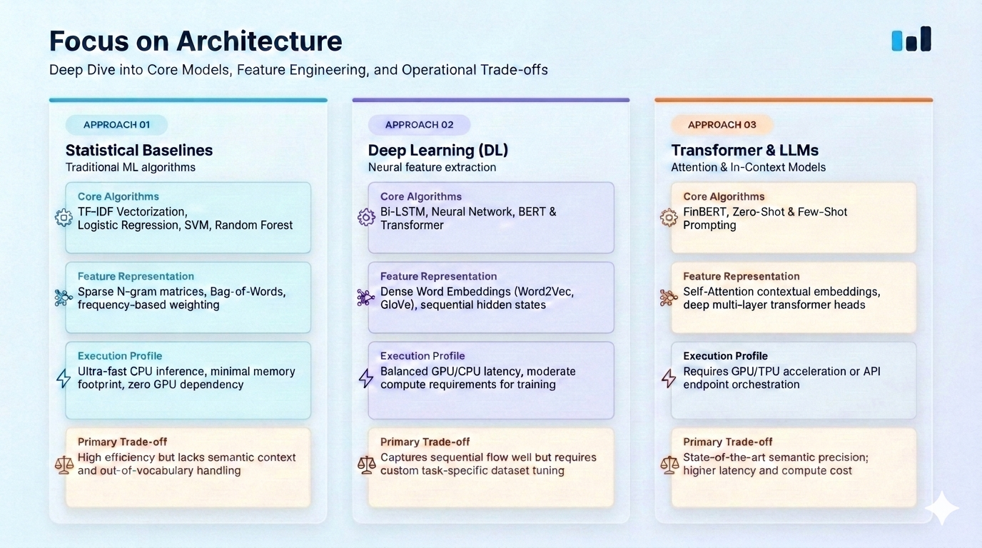

Slide 6
Evaluation & Performance Comparison
Benchmarking Model Accuracy, Precision, Recall, and F1-Score on Financial PhraseBank
BENCHMARK DATASET
EXPERIMENTAL RESULTS
Financial PhraseBank
Standardized evaluation dataset containing sentiment-annotated financial news phrases.
Model Performance Comparison Table
Model
Configuration
Accuracy
Precision
Recall
F1-score
Dataset Composition
Polar sentiment classification (Positive, Neutral, Negative) annotated by financial domain experts.
FinBERT
Fine-tuned
0.86
0.86
0.86
0.86
openai/gpt-oss-120b
Zero-shot
0.72
0.51
0.72
0.60
✓ Evaluation Protocol
Identical test split applied across Zero-Shot, Few-Shot, and Fine-Tuned model paradigms.
openai/gpt-oss-120b
Few-shot
0.72
0.51
0.72
0.60
Logistic Regression
TF-IDF N-gram
0.75
0.74
0.75
0.74
Support Vector Machine
Linear Kernel
0.78
0.77
0.78
0.77
⚠ Primary Observation
Fine-tuned domain models outperform zero/few-shot general LLMs on domain terminology precision.
Random Forest
Subsampled TF-IDF
0.74
0.73
0.74
0.73

Slide 7
Demo Section & Interactive Testing UI
Unified interactive playground for evaluating Statistical Baselines, Deep Learning, and LLM Inference Paradigms
STATISTICAL DEMO 01
DEEP LEARNING DEMO 02
LLM DEMO 03
Statistical Models UI
Baseline ML model inferencing environment
Deep Learning Based Models
Domain Fine-Tuned Transformer Models
Large Language Models (LLMs)
Open & Closed OSS Foundation Models
KEY TARGETS & FEATURES
Models: Logistic Regression, Linear SVM, Random Forest
Vectorization: TF-IDF (1,2-grams)
Latency: Ultra-fast CPU inference (<10ms)
Dataset: Financial PhraseBank / News Headlines
Output: Class probability & confidence scores
KEY TARGETS & FEATURES
DL Baselines: Bi-LSTM, Neural Network, Transformer
Paradigm: Fine-tuned task-specific pre-training
Accuracy: High precision on domain vocabulary
Dataset: Financial PhraseBank
Evaluation: High classification reliability & low latency
KEY TARGETS & FEATURES
Models: GPT-OSS-120b, Qwen3.8-27b, Gemini-3.5-Flash-Lite
Paradigm: Zero-Shot & Few-Shot Prompting
Flexibility: High textual adaptivity
Integration: REST API Endpoint Orchestration
Output: Multi-prompt structured predictions
🔗 Open Notebook Demo
🔗 Open Notebook Demo
🔗 Open Notebook Demo

Slide 8
Conclusion & Research Limitations
KEY TAKEAWAYS & FINDINGS
RESEARCH LIMITATIONS
Comparative Analysis
Benchmarking general-purpose LLMs (GPT-OSS-120b, Qwen3.8-27b, GPT-OSS-20b, Gemini-Flash-Lite-Latest) against domain-specific models highlights the efficacy of task-specific pre-training on financial corpora.
Domain vs. Generalization
FinBERT excels in financial sentiment tasks but lacks the broad conversational generalization and context adaptivity of large foundation models.
Fine-Tuning Impact
FinBERT, pre-trained and fine-tuned on Financial PhraseBank, demonstrates robust domain vocabulary understanding and high classification reliability with low inference latency.
API vs. Local Inference
LLM evaluation via API endpoints introduces rate-limiting and latency constraints compared to dedicated local transformer inference setup.
Prompt Paradigm Flexibility
While general LLMs require careful prompt tuning or few-shot examples to achieve comparable performance, they offer significantly greater flexibility across diverse textual formats.

Slide 9
FLOOR OPEN
Questions & Answers
Open forum for discussion, feedback, and further inquiries.
forum
Have any questions?
Feel free to ask anything about the presentation topics, methodology, or outcomes.

